Slide 1
Model Based Testing
Artur Ferreira - up201204899
Joanna Trojak - up201901613
Amr Abd Alrahman - up201903073
Notes:
Joanna

Slide 2
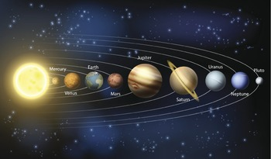
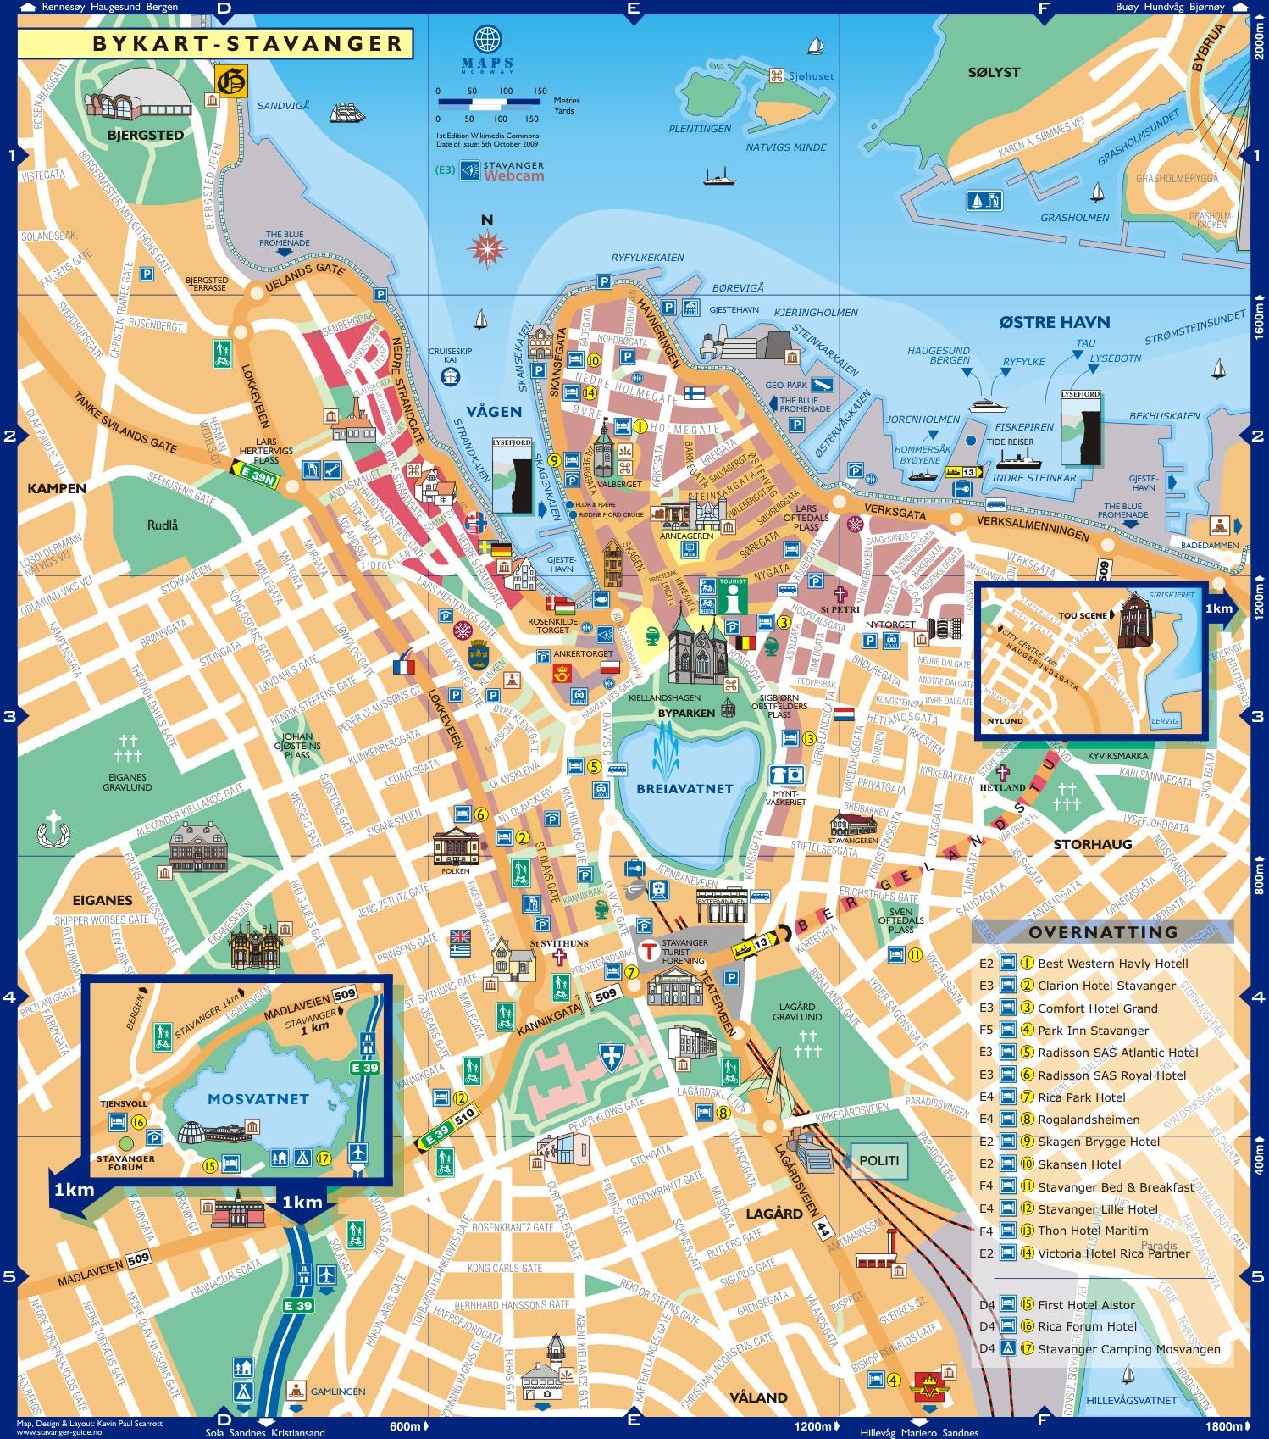

Notes:
Joanna

Slide 3
WHAT THOSE THINGS HAVE IN COMMON?
Notes:
Joanna

Slide 4
A model is a task-driven representation of a system that we study. Conceptual models are mind-concepts, physical models are material.
We can say that a Model(M) for a System (S) is is anything that can be applied to answer a Question (Q) about (S).
Notes:
Joanna

Slide 5
Modelling Notations
Notes:
Amr

Slide 6
Modeling Notations
Most used notations in MBT to model the behaviour of SUT are:
Pre/post (or state-based) notations
For example, UML OCL (i.e. UML Object Constraint Language).
Transition-based notations.
For example, FSM (i.e. Finite State Machine).
Others:
History-based notations.
Functional notations.
Operational notations.
Statistical notations.
Data-flow notations.
Notes:
amr

Slide 7
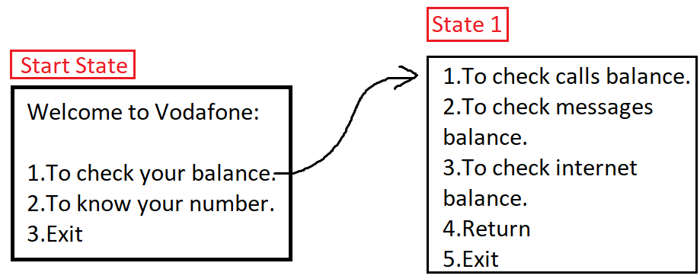
Pre/post vs Transition-based
Pre/post notations are better for data-oriented systems.
can be used to model control oriented systems,but yet harder.
Transition-based notations are better for control-oriented systems.
can be used to model data-oriented systems, but harder.
Notes:
amr

Slide 8
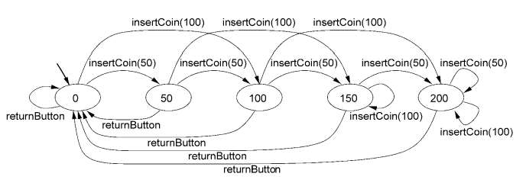
FSM (Finite State Machines)
Graph that has nodes and directed arcs.
The nodes represent the states of the system.
directed arcs represent transitions between states (i.e. nodes)
An important restriction when modeling a system.
Finite number of states.
Finite number of transitions.
Notes:
amr

Slide 9
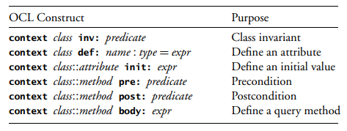
UML OCL
declarative language designed for object-oriented programmers.
avoids use of unfamiliar mathematical symbols.
used to :
constrain class diagrams.
specify preconditions and postconditions of methods.
specify guards of transitions within a UML state machine.
specify action part of transitions within a UML state machine.
Notes:
amr

Slide 10
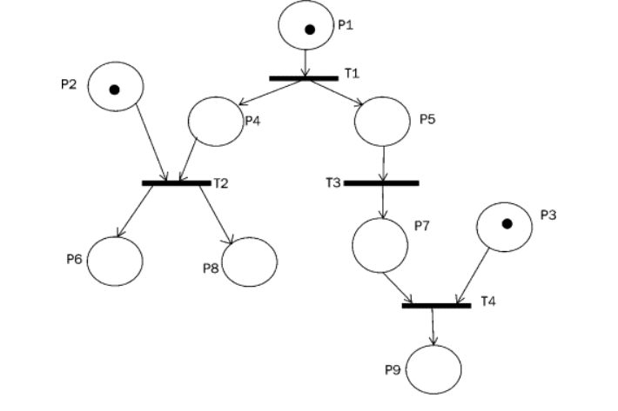
Petri Nets
were originally invented by Carl Adam Petri in 1939 for the purpose of describing chemical processes
a graphical notation for modelling stepwise processes
Directed graph with two types of nodes, the states, represented by circles, and the transitions, represented by bars, these nodes are linked with directed arcs
Notes:
amr

Slide 11
Model Based Testing
Notes:
Joanna

Slide 12
Model based testing is “the automation of test design”.
Notes:
Joanna

Slide 13
Test cases
Reqs
Test cases
Req
Model
Notes:
Joanna

Slide 14
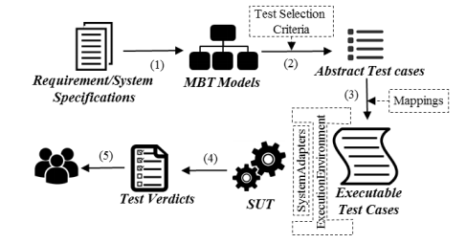
Notes:
Joanna

Slide 15
Online vs Offline Testing
Online testing:tests are executed while they are being generated.
Good for long-running test sessions, such as overnight testing based on random traversal of a model.
Offline testing:complete test suite is generated first, then executed later.
can perform a deeper analysis of the model to generate a small but powerful test suite.
generated test suite is a stand-alone product.
Notes:
Joanna

Slide 16
Test Generation in FSM
Test generation methods differ according to the modeling notation.
However, for FSM here are the Types of coverage:
State
Input
Output
Transitions (recommended)
Random path.
Transition tour of the FSM (Chinese postman algorithm).
Notes:
Joanna

Slide 17
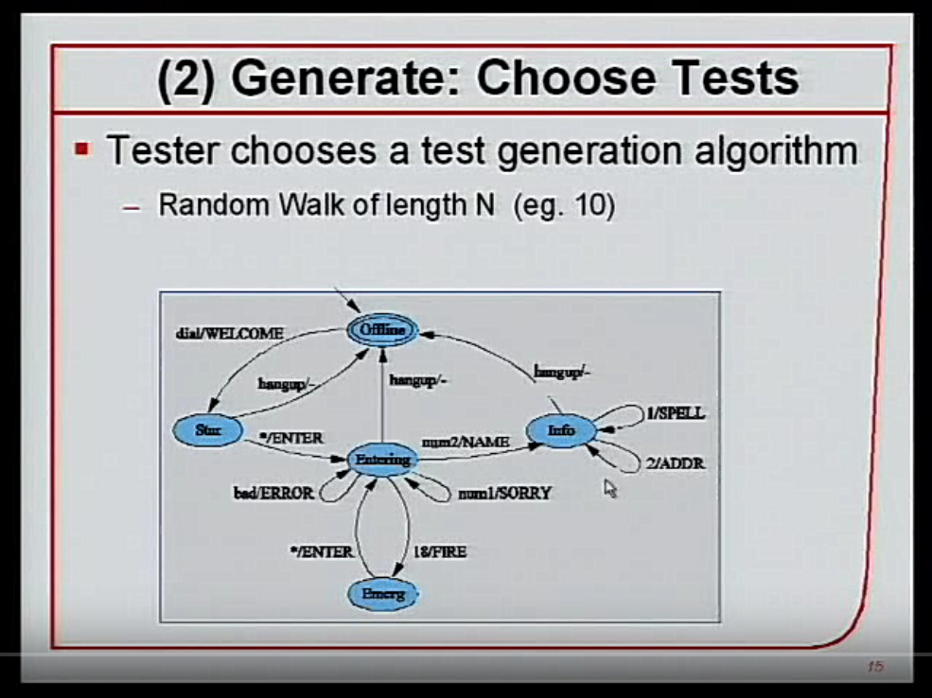
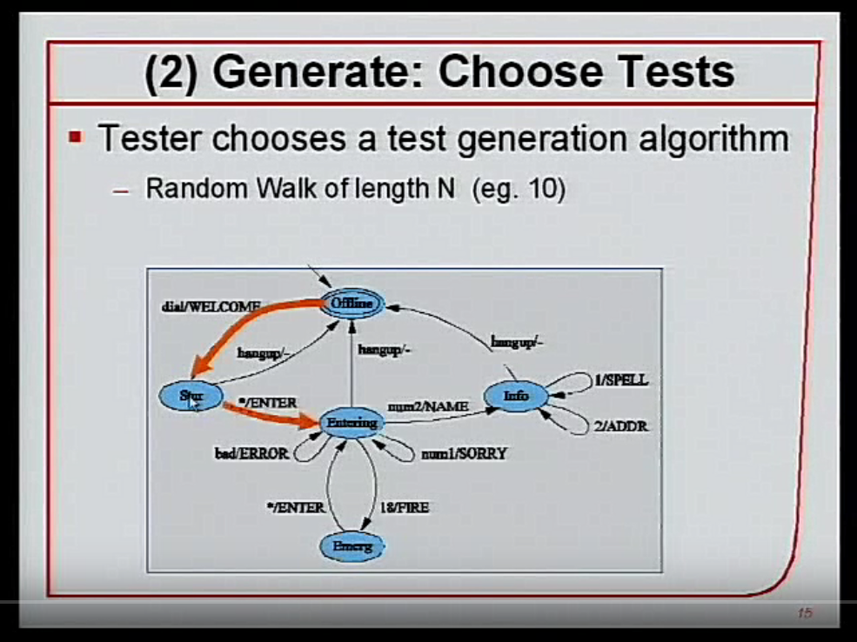
Random Walk of length n
Notes:
Joanna

Slide 18
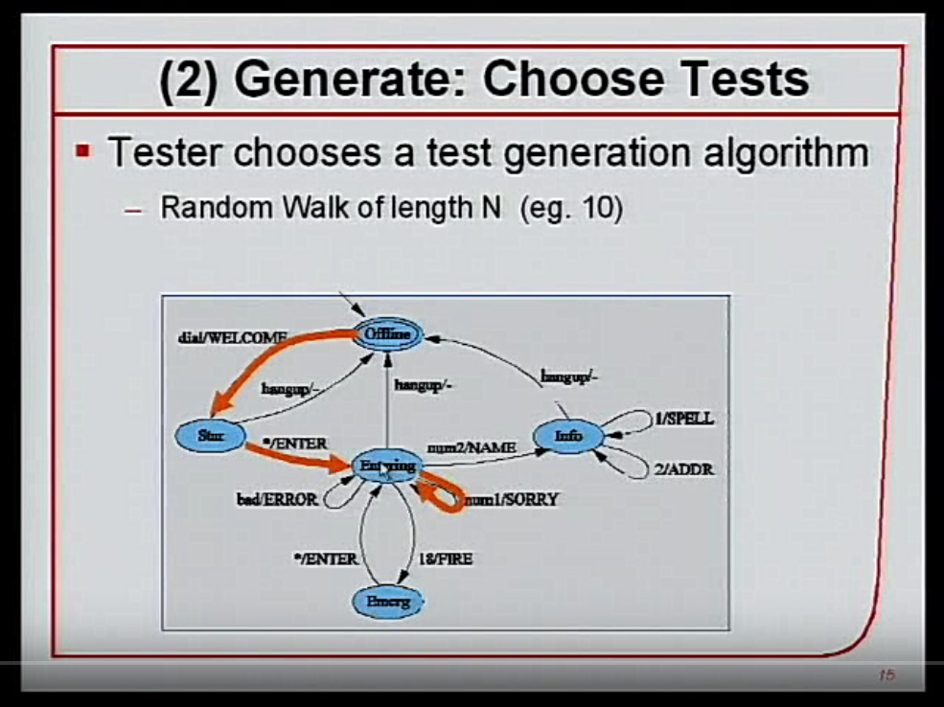
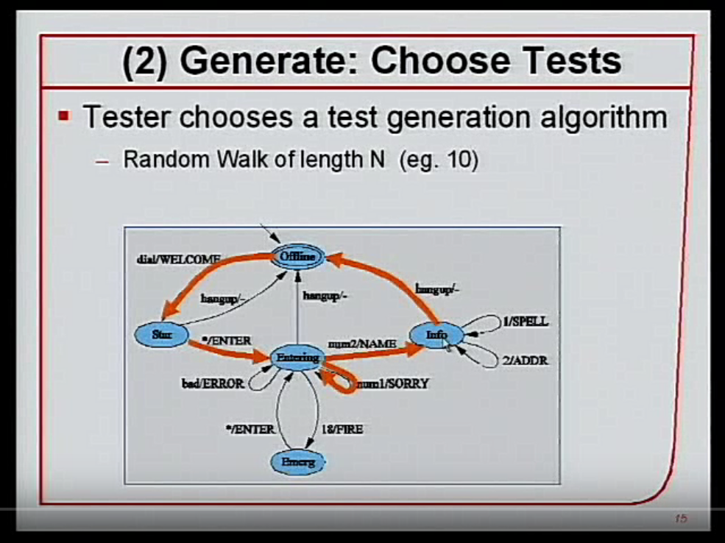
Random Walk of Length n
Notes:
Joanna

Slide 19
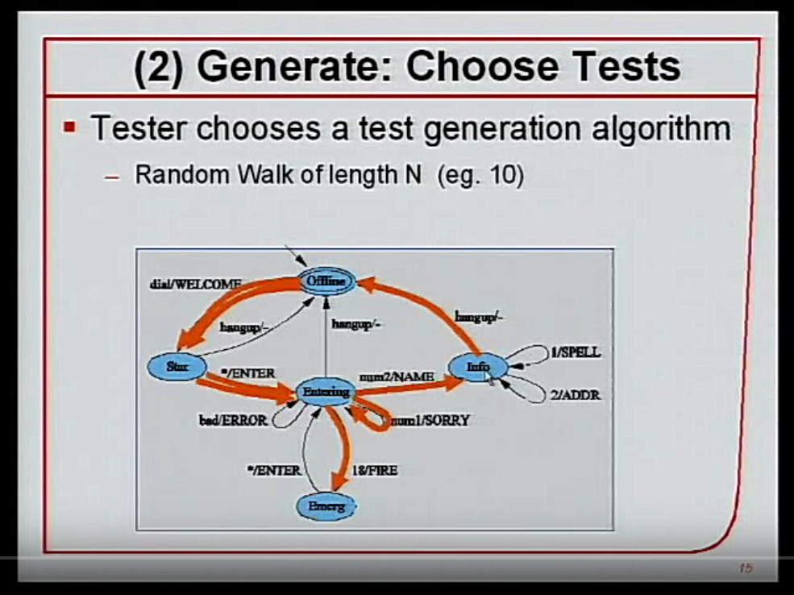
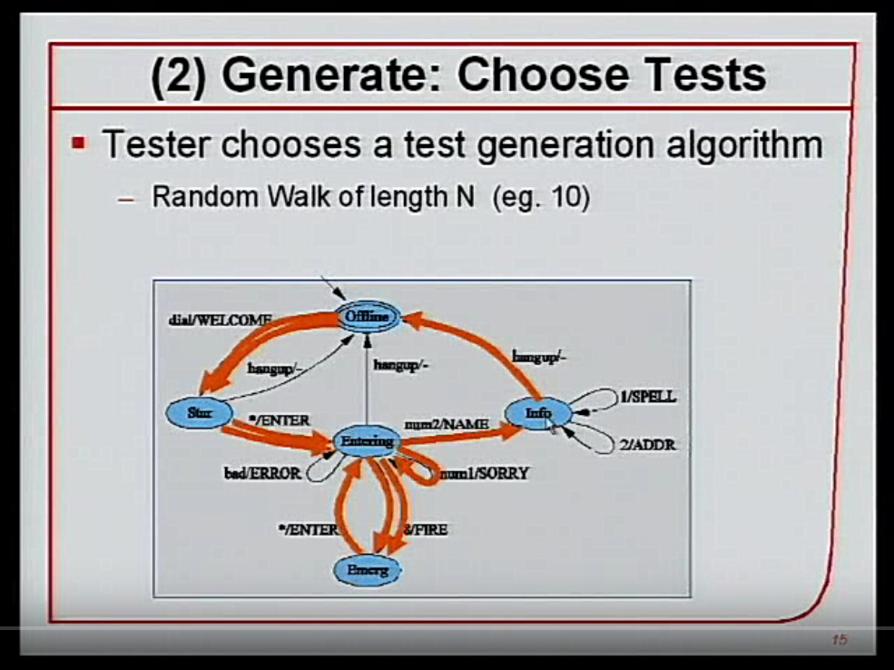
Random Walk of Length n
Notes:
Joanna

Slide 20
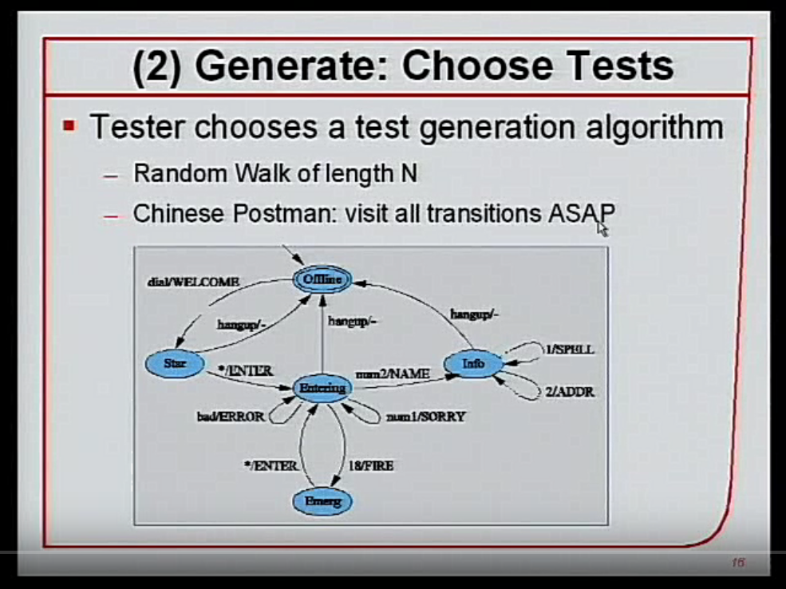
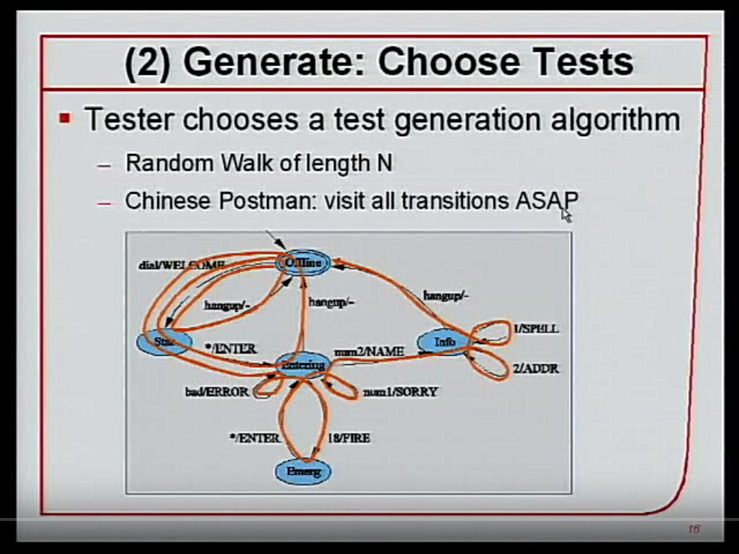
Chinese Postman Algorithm - visit all transitions ASAP
Notes:
Joanna

Slide 21
WHY WE SHOULD TEST MODELS?
 | PROCESS | HAND | SCRIPT | MBT
 | Make specifications
 | Make model
 | Make test
 | Predict outcome
 | Script test
 | Execute test
 | Check outcome
Notes:
Artur

Slide 22
WHY WE SHOULD BE CAREFUL WITH MODEL BASED TESTING?
Introducing MBT is a change
Models also can have bugs
Cannot guarantee to find all differences between the model and the implementation
Steep learning curve
Need of skilled model designers
Mostly (only) for functional testing
Some tests not easily automated: eg. installation process
Notes:
Artur

Slide 23
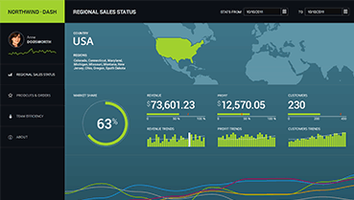



Notes:
Artur

Slide 24
Tools
Notes:
Artur

Slide 25

Tools source : http://mit.bme.hu/~micskeiz/pages/modelbased_testing.html
Tools | Links | Input | Description
Conformiq Creator (Commercial) |  | Activity Diagrams, DSL | Creator uses a custom modeling language which is based on activity diagrams and a graphical domain specific action language.
DTM Tool (Commercial) |  | custom activity model | The DTM (Dialogues Testing Method) tool uses a custom activity model (actions, decisions...), and selects tests based on structural coverage (multiple condition or all path).
GraphWalker (Open Source) |  | FSM | Test generation from Finite State Machines. Search algorithms: A* or random, with a limit for various coverage criteria (state, edge, requirement). Formerly called as mbt.
MISTA (Academic) Not developed any more |  | state machines, Function Nets | MISTA generates test cases from high-level Petri nets, and using a mapping it can generate executable test code for various platforms (JUnit, NUnit, Selenium...). It can be used for functional or security testing.
Notes:
Artur

Slide 26
MISTA: Model-based Integration and System Test Automation
easy to learn and use
suitable for function testing, acceptance testing, GUI testing, security testing, and programmer testing
supports automated generation of executable test code
supports a number of languages (Java, C, C++, C#, PHP, Python, HTML, and VB)
supports test frameworks (e.g., xUnit, Selenium IDE, and Robot Framework) for test execution
Notes:
Artur

Slide 27
Conclusion
Notes:
Joanna

Slide 28
Conclusion
Test suites are generated automatically. Lower maintenance. Separation of test design from code implementation. Improved test quality. Exposing requirements issues.
Expected behaviour of the system. Digital model based on formal methods. Digital twin.
WHAT
WHY
HOW
WHO
The domain expert manages and measures the software development for both external and internal development.
Using different model notations including UML, FSM etc.
Notes:
Joanna

Slide 29
References
Utting, Mark, and Bruno Legeard. Practical Model-Based Testing: a Tools Approach. Morgan Kaufmann, 2007.
http://mit.bme.hu/~micskeiz/pages/modelbased_testing.html
https://youtu.be/psOThLDKOFc
Notes:
Joanna

Slide 30

Thank you for your time!
Notes:
ALL

